Slide 1
Abstract Reasoning Challenge
https://www.kaggle.com/jamesmcguigan/arc-geometry-solvers

Slide 2
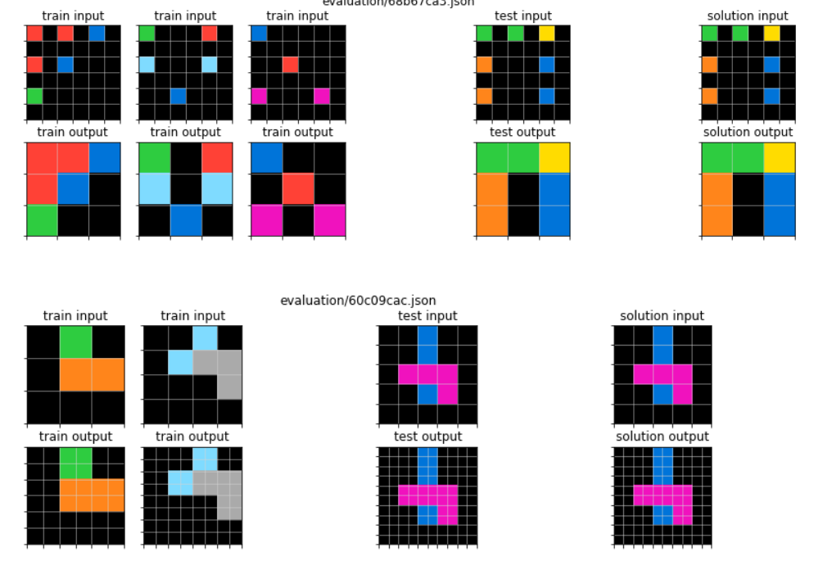

Slide 3
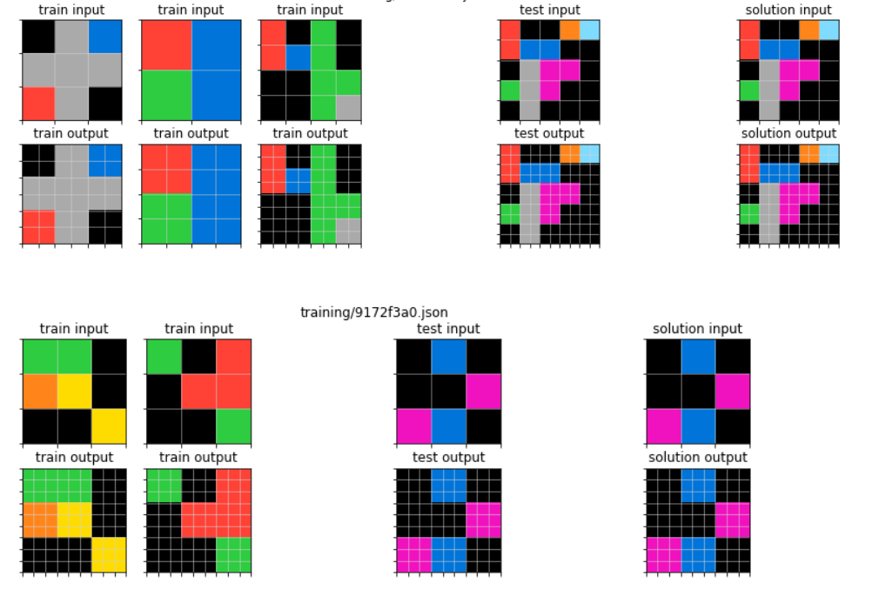

Slide 4
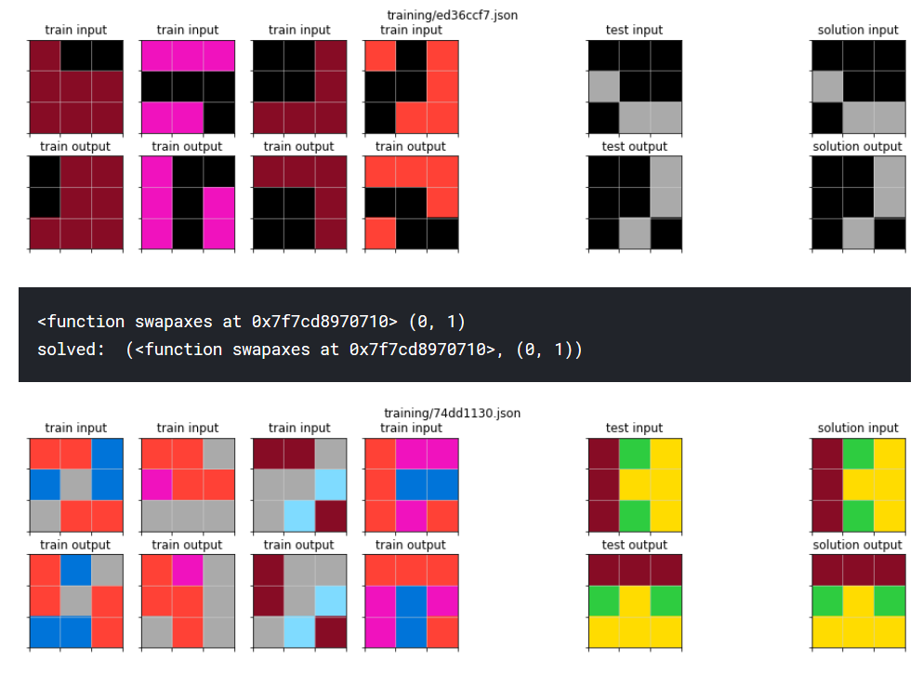

Slide 5



Slide 6



